Slide 1
WebDriver (Selenium) Page Object Model

Slide 2

What is Selenium?
Selenium is a suite of tools for automating web browsers.

Slide 3

What is Selenium?
Selenium WebDriver is the heart of the Selenium project and it is often known as simply Selenium
“Selenium WebDriver drives a browser natively, as a real user would, either locally or on remote machines.“

Slide 4
Alternatives For Test Automation
Cypress - https://www.cypress.io/
Playwright - https://playwright.dev/
Appium - http://appium.io

Slide 5

What is NOT Selenium?
Selenium is NOT a testing framework
Selenium is NOT a testing library

Slide 6


Slide 7
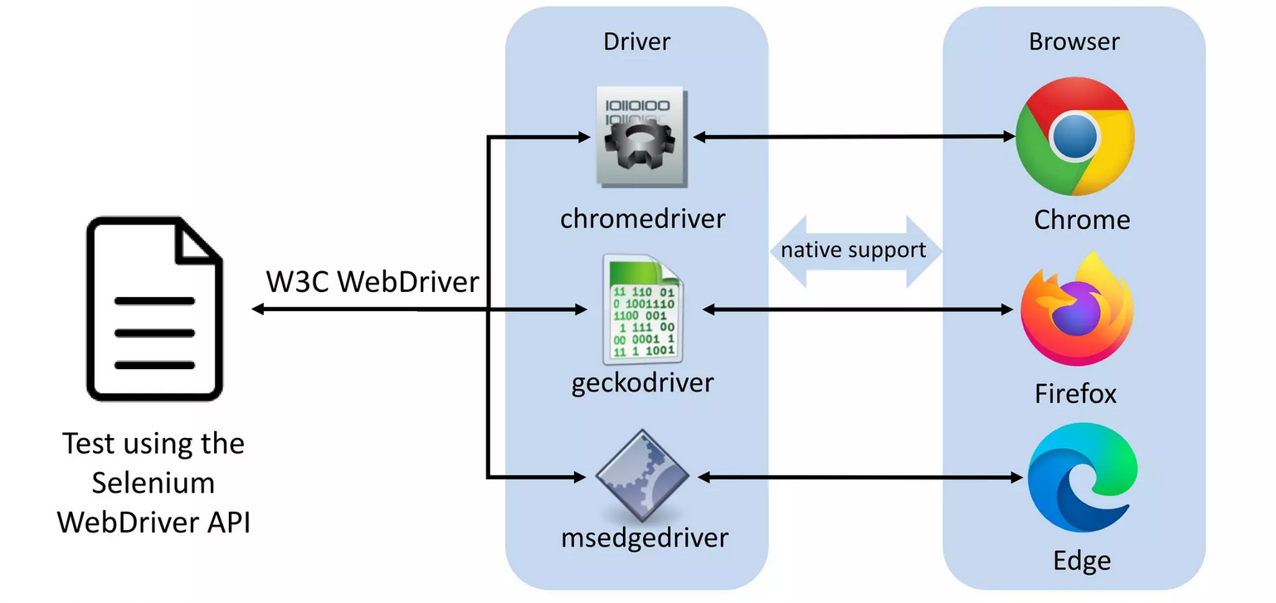
Drivers

Slide 8



Browsers
First we need one or more browsers to bedriven with Selenium
- Local
- Remote
- Cloud

Slide 9
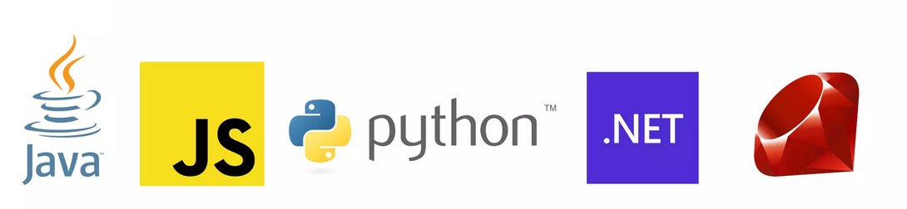
Binding Languages
Selenium provides a cross-browser Application Programming
Interface (API) in several programming languages

Slide 10
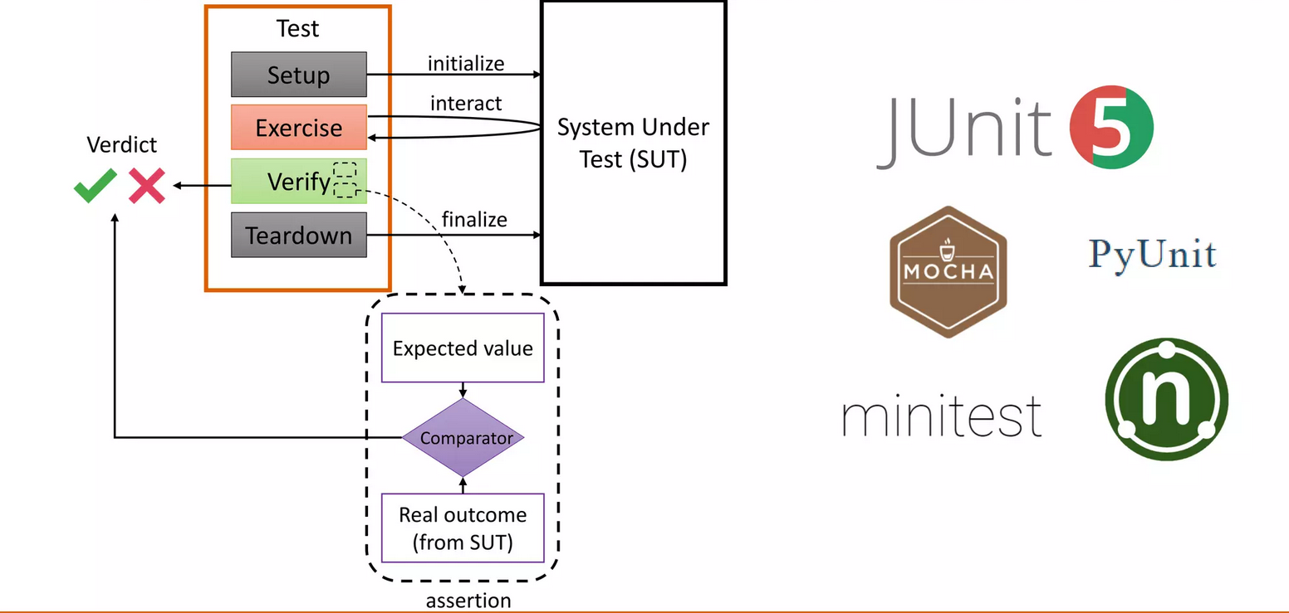
Unit testing framework

Slide 11
Selenium 3 vs Selenium 4
Architecture of Selenium 3 vs Selenium 4
Chrome Driver
Optimized Selenium Grid in Selenium 4
Selenium 4 IDE
Relative Locators
Chrome DevTools
DesiredCapabilities
Actions Class

Slide 12
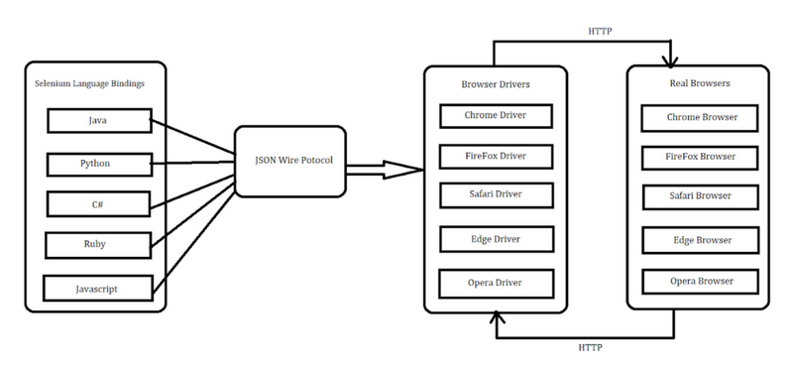
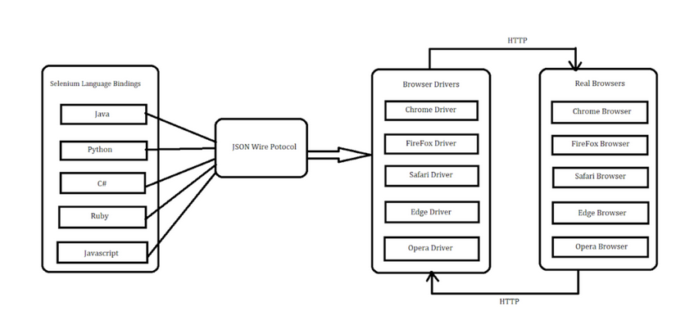
Selenium 3 vs Selenium 4
Selenium 3
Selenium 4

Slide 13
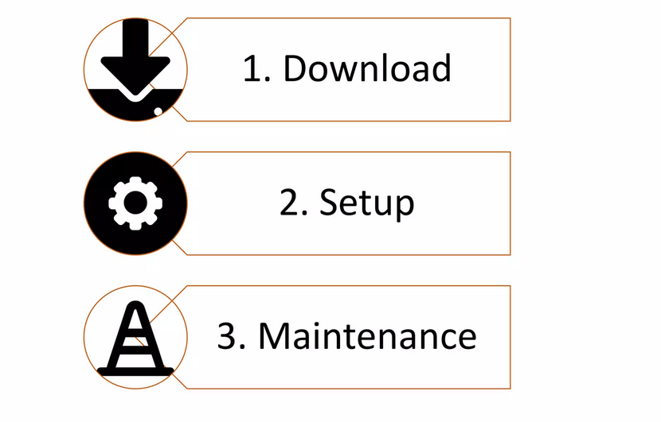
Driver management
Notes:
https://googlechromelabs.github.io/chrome-for-testing/

Slide 14
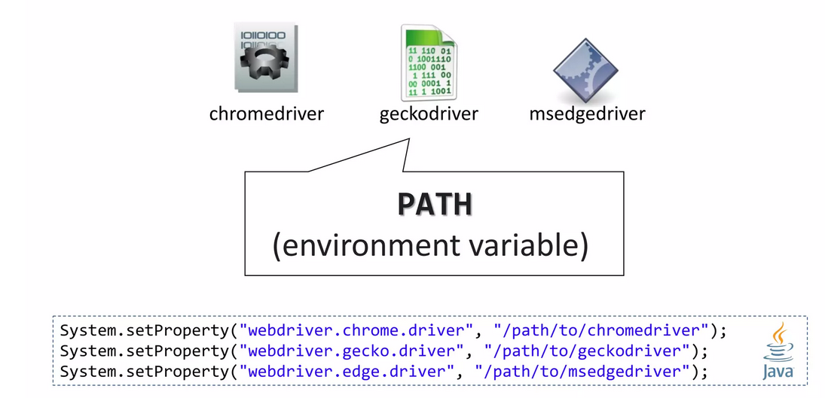
Driver management -setup

Slide 15
WebElement
Locator strategies
Ways to identify one or more specific elements in the DOM.
Finding web elements
Locating the elements based on the provided locator values.
Interacting with web elements
A high-level instruction set for manipulating form controls.
Information about web elements
What you can learn about an element.

Slide 16
WebElement - Waiting Strategies
pageLoadStrategy
ChromeOptions chromeOptions = new ChromeOptions(); chromeOptions.setPageLoadStrategy(PageLoadStrategy.NORMAL);
Implicit waits
driver.manage().timeouts().implicitlyWait(Duration.ofSeconds(2));
Explicit waits
WebElement revealed = driver.findElement(By.id("revealed")); Wait<WebDriver> wait = new WebDriverWait(driver, Duration.ofSeconds(2)); driver.findElement(By.id("reveal")).click();
wait.until(d -> revealed.isDisplayed());
revealed.sendKeys("Displayed");

Slide 17
WebElement -Locator strategies
Absolute
/html[1]/body[1]/div[2]/div[2]/main[1]/div[1]/section[2]/
Relative
//span[text()=’Plovdiv University ]
https://www.swtestacademy.com/xpath-selenium/
https://www.swtestacademy.com/css-selenium/

Slide 18
WebElement - Iteraction
click (applies to any element)
send keys (only applies to text fields and content editable elements)
clear (only applies to text fields and content editable elements)
submit (only applies to form elements)
select

Slide 19
WebElement - Information
Is Displayed
Is Enabled
Is Selected
Size and Position
Get CSS Value
Text Content

